Slide 1

Design & Analysis of Algorithm
Name: Alamin
Master of Science in Computer Science (MSCS)
American International University-Bangladesh (AIUB)

Slide 2

What is design & analysis of Algorithm?
The design and analysis of algorithms is a fundamental field in computer science that focuses on developing efficient and effective algorithms to solve various computational problems. An algorithm is a step-by-step set of instructions or procedures to perform a specific task or solve a problem. Designing algorithms involves creating these instructions, while analyzing algorithms involves evaluating their efficiency and performance characteristics.

Slide 3
Why Analysis of Algorithms is important?
To predict the behavior of an algorithm without implementing it on a specific computer.
It is much more convenient to have simple measures for the efficiency of an algorithm than to implement the algorithm and test the efficiency every time a certain parameter in the underlying computer system changes.
It is impossible to predict the exact behavior of an algorithm. There are too many influencing factors.
The analysis is thus only an approximation; it is not perfect.
More importantly, by analyzing different algorithms, we can compare them to determine the best one for our purpose.

Slide 4

What is an Algorithm?
An algorithm is a finite set of unambiguous instruction that if followed accomplishes a particular task.
An algorithm should have finite number of steps.
It should accept input and produce desired output.
Algorithm should terminate.

Slide 5

Types Of Algorithm?
There are several types of algorithms available. Some important algorithms are:
Brute Force Algorithm: It is the simplest approach to a problem. A brute force algorithm is the first approach that comes to finding when we see a problem.
Recursive Algorithm: A recursive algorithm is based on recursion. In this case, a problem is broken into several sub-parts and called the same function again and again.
Backtracking Algorithm: The backtracking algorithm builds the solution by searching among all possible solutions. Using this algorithm, we keep on building the solution following criteria. Whenever a solution fails, we trace back to the failure point build on the next solution and continue this process till we find the solution, or all possible solutions are looked after.

Slide 6
Types Of Algorithm?
Searching Algorithm: Searching algorithms are the ones that are used for searching elements or groups of elements from a particular data structure. They can be of different types based on their approach or the data structure in which the element should be found.
Sorting Algorithm: Sorting is arranging a group of data in a particular manner according to the requirement. The algorithms which help in performing this function are called sorting algorithms. Generally sorting algorithms are used to sort groups of data in an increasing or decreasing manner.
Hashing Algorithm: Hashing algorithms work similarly to the searching algorithm. But they contain an index with a key ID. In hashing, a key is assigned to specific data.
Divide and Conquer Algorithm: This algorithm breaks a problem into sub-problems, solves a single sub-problem, and merges the solutions to get the final solution. It consists of the following three steps:
Divide
Solve
Combine
Greedy Algorithm: In this type of algorithm, the solution is built part by part. The solution for the next part is built based on the immediate benefit of the next part. The one solution that gives the most benefit will be chosen as the solution for the next part.

Slide 7
Types Of Algorithm?
Dynamic Programming Algorithm: This algorithm uses the concept of using the already found solution to avoid repetitive calculation of the same part of the problem. It divides the problem into smaller overlapping subproblems and solves them.
Randomized Algorithm: In the randomized algorithm, we use a random number, so it gives immediate benefit. The random number helps in deciding the expected outcome.
Geometric Algorithms: Geometric algorithms work with geometric shapes and solve problems like computational geometry, convex hull, and nearest neighbour search.
Parallel and Distributed Algorithms: These algorithms are designed to run on multiple processors or across a distributed network, utilizing parallel processing to solve complex problems.
Optimization Algorithms: Optimization algorithms are used to find the best solution or the optimal configuration in a given set of choices. Examples include linear programming and genetic algorithms.

Slide 8

Difference between algorithms and program
Algorithm:
An algorithm is a step-by-step procedure or set of rules to solve a specific problem or perform a specific task.
It is abstract and independent of any particular programming language.
It focuses on logic, efficiency, and correctness, providing a blueprint for solving problems.
Algorithms can be represented in various forms like pseudocode, flowcharts, or written instructions.

Slide 9
Difference between algorithms and program
Program:
A program is a concrete implementation of an algorithm, written in a specific programming language.
It is executable by a computer and involves actual code written to perform tasks based on the algorithm.
Programs include not just the algorithm but also other elements like input/output handling, memory management, and interaction with hardware.
Programs are run in real environments, and they need to consider constraints like resources, platform dependencies, and user interaction.

Slide 10
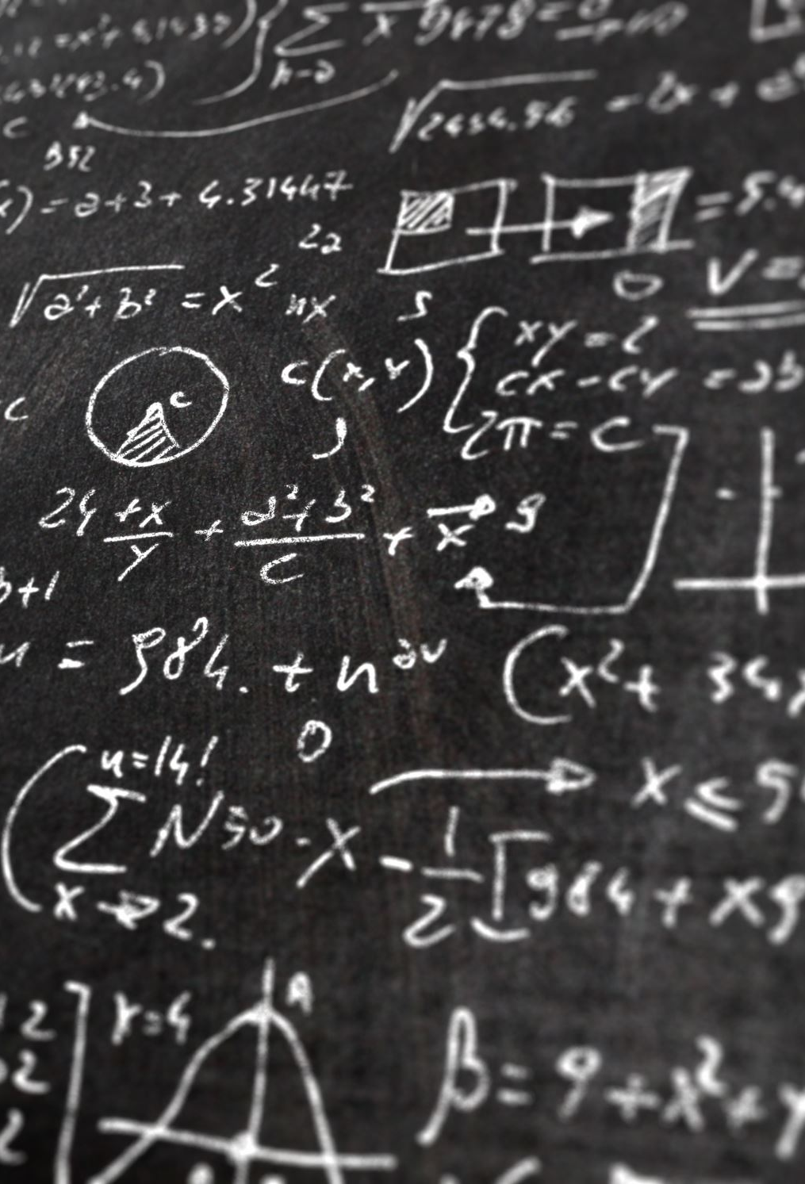
Design of Algorithms?
Here's a breakdown of the key components of the design and analysis of algorithms:
Problem Definition: Clearly define the problem you're trying to solve. This could be a mathematical problem, a data processing task, or any computational challenge.
Algorithm Design Strategies:
Divide and Conquer: Break down a complex problem into smaller subproblems, solve them individually, and combine their solutions.
Dynamic Programming: Store and reuse solutions to subproblems to avoid redundant computations.
Greedy Algorithms: Make locally optimal choices at each step to find a globally optimal solution.

Slide 11

Design of Algorithms?
Backtracking: Explore all possible solutions by incrementally building a solution and undoing choices when they don't lead to a valid solution.
Randomized Algorithms: Introduce randomness to solve problems efficiently or probabilistically.
Algorithm Analysis:
Correctness: Ensure the algorithm produces the correct output for all possible inputs.
Efficiency: Measure the efficiency of an algorithm in terms of time complexity (how many operations it takes) and space complexity (how much memory it uses).
Scalability: Analyze how the algorithm's performance scales as the input size grows.
Optimality: Determine whether an algorithm achieves the best possible solution for a given problem.
Trade-offs: Consider the trade-offs between time complexity, space complexity, and other factors like simplicity and maintainability.

Slide 12
Types of algorithms analysis?
Best Case: Best case refers to the scenario in which an algorithm performs optimally, achieving the lowest possible time or space complexity for a given input.
Average Case: Average case represents the expected performance of an algorithm when considering all possible inputs, typically based on probability distributions.
Worst Case: Worst case refers to the scenario in which an algorithm performs at its maximum time or space complexity for a given input, representing the most resource-intensive situation.

Slide 13
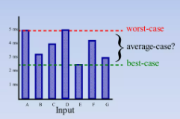
Types of algorithms analysis?

Slide 14
Types of complexity?
There are two types of complexity:
Space Complexity: Space complexity refers to the amount of memory or storage space an algorithm requires to complete its task, typically measured in terms of the additional memory used relative to the size of the input. It quantifies how efficiently an algorithm utilizes memory as the input size grows.
Time Complexity: Time complexity, on the other hand, measures the amount of computational time an algorithm takes to complete its task as a function of the input size. It helps assess how efficiently an algorithm performs in terms of execution time as the input size increases. Time complexity is often expressed using big O notation to describe the upper bound on the growth rate of the algorithm's running time with respect to the input size.

Slide 15
Types of complexity?
Both of the above complexities are measured with respect to the input parameters. But here arises a problem. The time required for executing a code depends on several factors, such as:
The number of operations performed in the program,
The speed of the device, and also
The speed of data transfer if being executed on an online platform.
So how can we determine which one is efficient? The answer is the use of asymptotic notation.
Asymptotic notation is a mathematical tool that calculates the required time in terms of input size and does not require the execution of the code.

Slide 16
Types of complexity?
It neglects the system-dependent constants and is related to only the number of modular operations being performed in the whole program. The following 3 asymptotic notations are mostly used to represent the time complexity of algorithms:
Big-O Notation (Ο) – Big-O notation specifically describes the worst-case scenario.
Omega Notation (Ω) – Omega(Ω) notation specifically describes the best-case scenario.
Theta Notation (θ) – This notation represents the average complexity of an algorithm.

Slide 17
Order Of Growth:
Goals:
want to evaluate the program efficiency when input is very big.
want to express the growth of programs run time as input size grows.
want to put an upper bound (worst case) on growth – as tight as possible.
do not need to be precise: “order of” not “exact” growth.
we will look at largest factors in run time (which section of the program will take the longest to run?)
thus, generally we want tight upper bound on growth, as function of size of input, in worst case.

Slide 18
Measuring Order Of Growth (Big O Notation):
Big O notation measures an upper bound on the asymptotic growth, often called order of growth.
Big O or O() is used to describe worst case
Worst case occurs often and is the bottleneck when a program runs.
Express rate of growth of program relative to the input size.
Evaluate algorithm Not machine or implementation.

Slide 19
What is time complexity?
Time complexity is a fundamental concept in the analysis of algorithms. It quantifies the amount of time an algorithm takes to run as a function of the size of its input. It helps us understand how the algorithm's performance scales with increasing input sizes. Time complexity is typically expressed using big O notation, which provides an upper bound on the growth rate of the algorithm's running time.

Slide 20
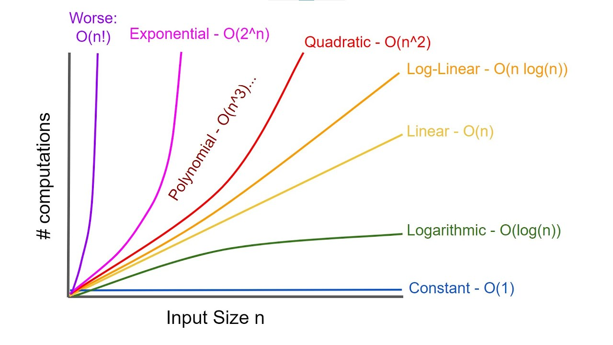
Time complexity graph?

Slide 21
Different time complexity?
Time complexity is a fundamental concept in the analysis of algorithms. It quantifies the amount of time an algorithm takes to run as a function of the size of its input. It helps us understand how the algorithm's performance scales with increasing input sizes. Time complexity is typically expressed using big O notation, which provides an upper bound on the growth rate of the algorithm's running time.
In big O notation, the time complexity of an algorithm is represented as "O(f(n))," where "f(n)" is a function that describes the upper bound on the number of basic operations (or steps) the algorithm takes as a function of the input size "n." Here are some common time complexity classes and their meanings:

Slide 22
Different time complexity?
O(1) - Constant Time: The algorithm's running time does not depend on the input size. It takes a constant amount of time to complete, regardless of how large the input is.
O(log n) - Logarithmic Time: The algorithm's running time increases logarithmically with the input size. Common with algorithms that divide the problem into smaller subproblems, such as binary search in a sorted list.
O(n) - Linear Time: The algorithm's running time increases linearly with the input size. Each input element is processed once.
O(n log n) - Linearithmic Time: Often seen in efficient sorting algorithms like merge sort and quicksort. The running time grows faster than linear but slower than quadratic.
O(n^2) - Quadratic Time: The running time is proportional to the square of the input size. Common with algorithms that involve nested loops, processing each input element against all other elements.

Slide 23
Different time complexity?
O(n^k) - Polynomial Time: Similar to quadratic time, but with a higher exponent "k." Polynomial time complexities like cubic (O(n^3)) or quartic (O(n^4)) are less efficient for large input sizes.
O(2^n) - Exponential Time: The running time grows exponentially with the input size. Often seen in brute-force algorithms that explore all possible combinations of input elements.
O(n!) - Factorial Time: The running time grows factorially with the input size. Highly inefficient and often impractical for even moderate input sizes.
When analyzing the time complexity of an algorithm, it's important to consider the worst-case scenario, as this provides an upper bound on the algorithm's performance. Additionally, factors like the specific operations performed in each step and the machine's architecture can influence the actual runtime.
As a programmer, understanding the time complexity of algorithms helps you choose the most appropriate algorithm for a given problem, optimize code for performance, and make informed decisions when developing software.

Slide 24
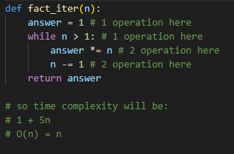
Measuring time complexity?
Count all the operations of the program.
Worst case asymptotic complexity:
Ignore additive constants.
Ignore multiplicative constants.
time
input

Slide 25















Some Exercise
$${=n}^{2}+2n+2$$
$${=n}^{2}+200000n+3^{10000}$$
$$=log(n)+n+2$$
$${O(n)=n}^{2}+2n$$
$${O\left(n\right)= n}^{2}+200000n$$
$$O\left(n\right)= log(n)+n$$
$${O(n)=n}^{2}+n$$
$${O\left(n\right)= n}^{2}+n$$
$$O\left(n\right)= n$$
$${O(n)=n}^{2}$$
$${O\left(n\right)= n}^{2}$$
$$=0.001∗n∗log(n)+300n$$
$$O(n)=n∗log(n)+n$$
$$O(n)=n∗log(n)$$
$$O\left(n\right)=n log(n)$$

Slide 26
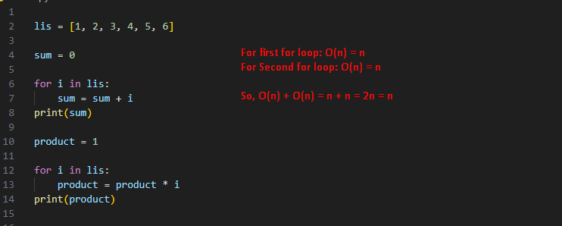
How to calculate time complexity?

Slide 27
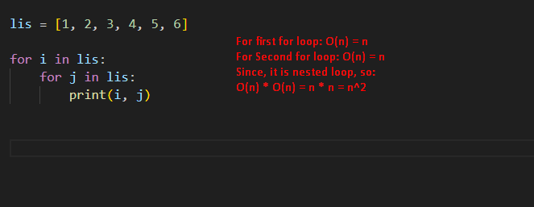
How to calculate time complexity?

Slide 28
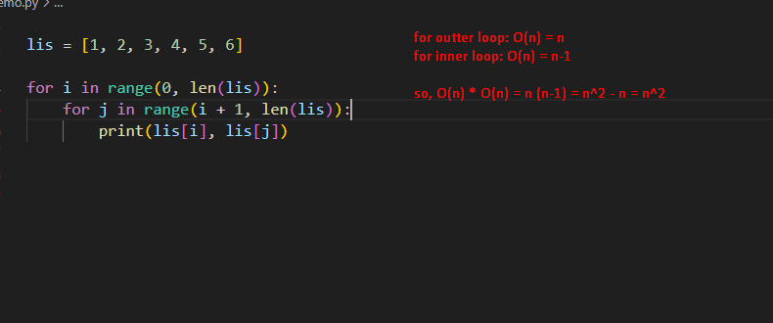
How to calculate time complexity?

Slide 29
Important problems types
Sorting.
Searching.
String processing.
Graph problems.
Combinatorial problems.
Geometric problems.
Numerical problems.

Slide 30
Complexity Classes
P class.
NP class.
NP hard class.
NP complete class.

Slide 31
References
https://www.geeksforgeeks.org/design-and-analysis-of-algorithms/?ref=outind
https://www.geeksforgeeks.org/learn-data-structures-and-algorithms-dsa-tutorial/?ref=outind
https://www.geeksforgeeks.org/types-of-complexity-classes-p-np-conp-np-hard-and-np-complete/
https://www.geeksforgeeks.org/introduction-to-algorithms/?ref=ghm
https://www.geeksforgeeks.org/most-important-type-of-algorithms/

